Slide 1
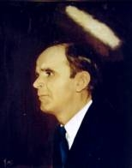

86
ROOM AT THE FOUNTAIN
The cross upon which Jesus died
Is a shelter in which we can hide,
And its grace so free is sufficient for me,
And deep is its fountain, as wide as the sea.

Slide 2
CHORUS
There’s room at the cross for you,
There’s room at the cross for you,
Though millions have come, there’s still room for one,
Yes, there’s room at the cross for you.

Slide 3
Though millions have found Him a friend
And have turned from the sins they have sinned.
The Saviour still waits to open the gates,
And welcome a sinner before it’s too late.

Slide 4
The hand of my Saviour is strong
And the love of my Saviour is long,
Through sunshine or rain, through loss or in gain.
The blood flows from Calv’ry to cleanse every stain.

